Slide 1
Stanford’s AHA (Agile Hardware) Center (A Personal Story)
Mark Horowitz
6/22/2018

Slide 2
I’ve Worked in VLSI for a Long Time

Slide 3
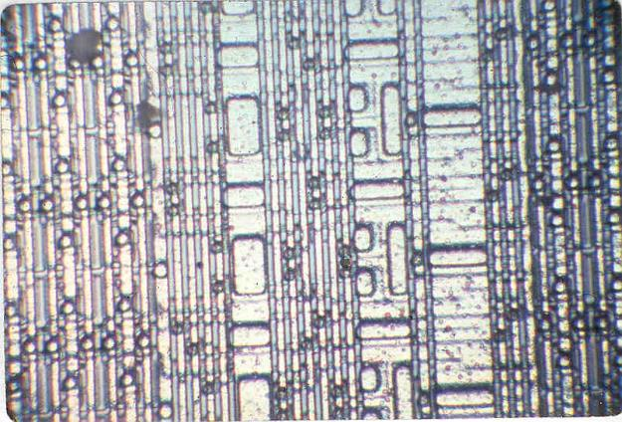
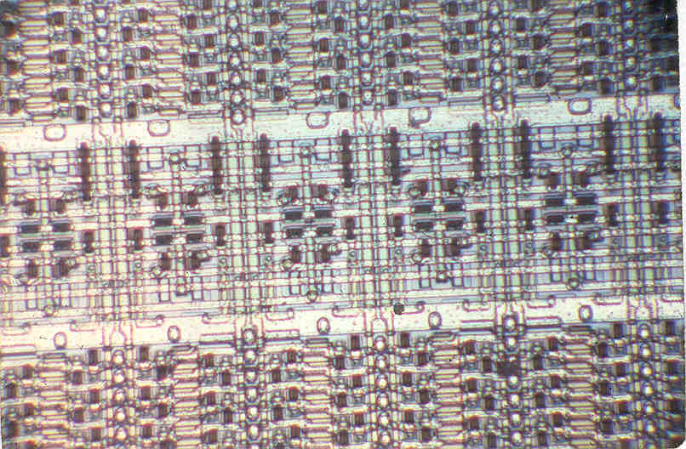
1978 – Hello Silicon Valley
Hot new technologies
3μ nMOS
Depletion loads and 5V operation, TTL I/O
HMOS –2147 at Intel
VMOS at AMI

Slide 4
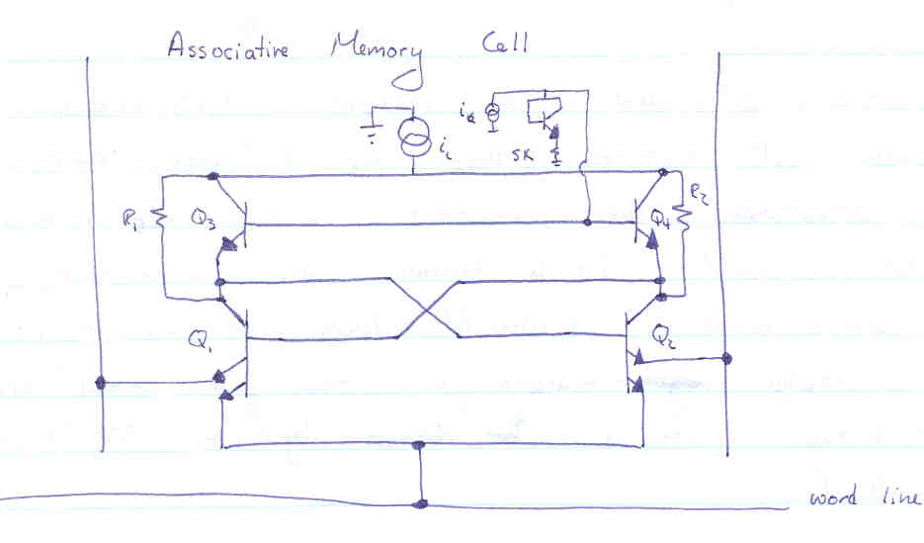
Worked at Signetics
Worked on bipolar designs
1 kbit ECL CAM, ISL gate array
Design Flow
We did have circuit simulation
And I never used rubylith

Slide 5
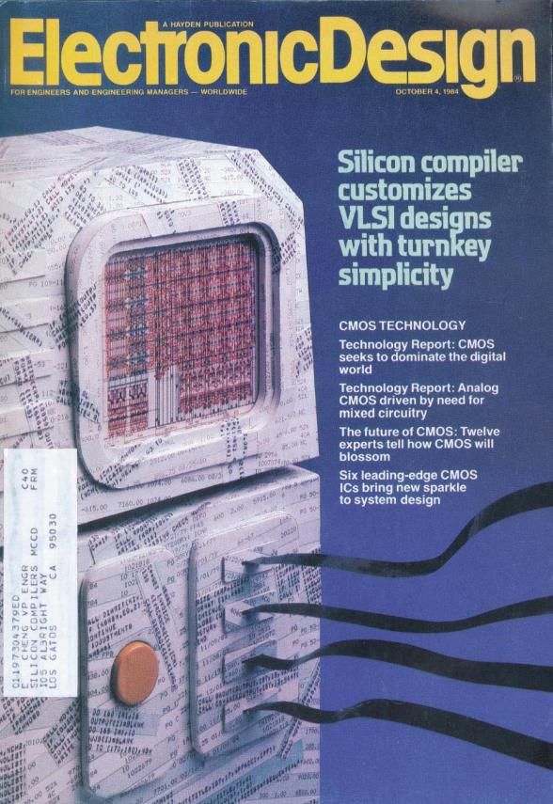
Experienced the Innovative 1980s
Schematic capture
Mentor, Daisy, Valid
Academic design revolution
Mead and Conway
Layout
Gate arrays
Stick diagrams
Silicon compilers

Slide 6
Optimal Solutions (a.k.a.) Synopsys
Started as a logic optimization company
Netlist to better netlist
When Verilog was a simulation language
Place and route was what you did on boards

Slide 7
Chip Designers Were Skeptical of ASICs
I should know, I was one of them
They were ignoring tons of critical issues
Wires were important, set speed, routability
There were a lot of circuit “tricks” that they couldn’t do
We were right and completely wrong

Slide 8
Why ASICs Won No One Does Custom Design Today
It allowed system designs to create the chips they wanted
Faster application performance using slower circuits
For the same reason few people write assembly code today
And yes, libraries are still customized (for both)

Slide 9
Why Synthesis, Place and Route Won
It was a very clean abstraction layer
You abstracted away all layout issues
Allowed many people to start designing chips
Leveraged the entire industry
New routers, and placers were constantly being created
No one company had all the good ideas
Or resources to do all the steps
Silicon compilers bit off too much in one go
Had to create the libraries, and all the tools

Slide 10
30 Years Later

Slide 11
VLSI is Stalling
Scaling is not what it used to be
Dennard scaling is dead, so power is everything
And scaling no longer has the economic gain it use to

Slide 12
VLSI is Stalling, cont’d
Building complex chips costs lots of money
So fewer and fewer people can afford it
And when you build something expensive, the mantra is don’t f*ck up.

Slide 13
It Was So Depressing …
Started looking for new research areas …

Slide 14
But, It Was Clear To Me…
To continue to create innovation silicon solutions
We needed another design revolution
To decrease the cost to play
Had an idea …

Slide 15

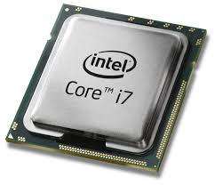
Cup Holders
Small additions to a complex product
With large perceived value

Slide 16
The New Challenge:
How to efficiently create these systems w/ cup holders
Which is much harder than producing the cup holder
Porting an application to hardware
Is about reframing the algorithm as much as hardware design
Need expertise in the application area and hardware design

Slide 17
But …
Doing this would require a huge effort in:
Creating the base system to add cup holders
Tool flows to bring design to the next level
And VLSI tools research is even less popular than VLSI design …

Slide 18
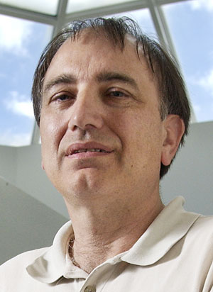
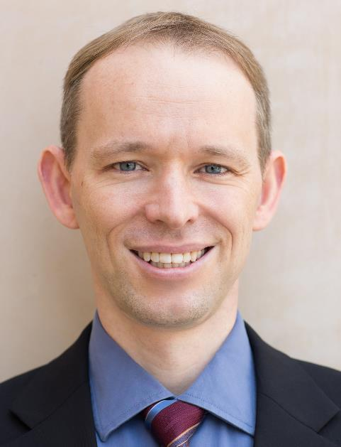

My Saviors

Slide 19
Software Techniques
Open source software
Large systems that people leverage for them specialized stuff
Use both open source tools to create stuff, and open source systems
High level languages / Meta-programmed execution
Templates / Constructor
Don’t build a library
Build a tool that can optimize library for your application
Agile Design
If you don’t know what is going to win, cycle quickly

Slide 20
Validation
It is the hardest part of design
What you spend most of your time doing
Built some of the best SMT solvers
Interested in using this technology in new ways
Symbolic QED
Interested in creating new and better CAD tools, and tool flows

Slide 21
Intel ISTC on Agile Hardware
Enable application designers to create cupholder systems
Explore custom accelerators for their application
Requires creating agile (system &) hardware development tools
No one wants raw hardware
Need hardware and software to run on it
And software to seamlessly stitch it into the existing system
Use image/video processing as driving app

Slide 22
Real Saviors
Aina Niemetz, Ankita Nayak, Artem Vasilyev, Caleb Donovick, Cristian Mattarei, Dillon Huff, Jeff Setter, Leonard Truong, Makai Michael Mann, Nate Chizgi, Nikhil Bhagdikar, Ross G Daly, Steven Bell, Steve Richardson, Xuan Yang, Alex Carsello,Taeyoung Kong, Keyi Zhang, David Durst, Qiaoyi Liu, James Thomas

Slide 23

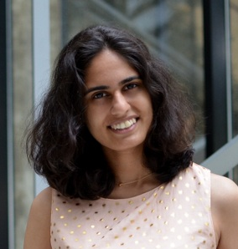
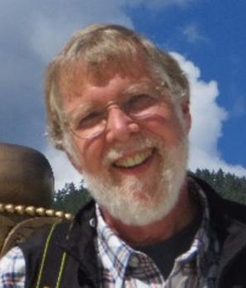
Reinforcements

Slide 25
Vision
Change the world by:
Showing that hardware/software system design
Doesn’t need to cost huge amounts of money
Doesn’t need to be done by silicon specialists
Doesn’t need to take years to produce
Our secret sauce:
Leveraging the lessons learned from software (again)
Realizing that we are going to reuse most of the system from last time
Make hardware/software system design fun again!

Slide 26
Specialized Hardware Mistake
Study the application
Build the hardware
Then write the software for the machine
And that is the only application this hardware will ever support…

Slide 27
Need an “ISA”
Need a stable target for compiler and hardware
This allows one to continue to optimize each side
And to run new applications on deployed hardware

Slide 28
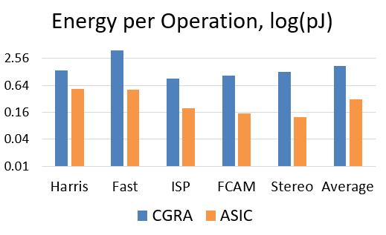
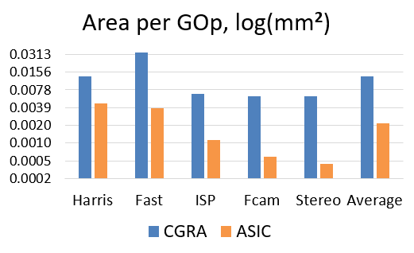
But
Cost of programmability is high

Slide 29
Optimizing w/ ISA An Agile Approach to Accelerators
Key idea:
Maintain end-to-end flow no matter what
Always be able to compile new applications
Incrementally change tools/fabric to improve performance
Accelerator becomes optimization of underlying fabric
Heterogeneous fabric, which may or may not need “new” instructions

Slide 30
CGRA is the Best Base Substrate
TILE
TILE
TILE
TILE
TILE
TILE
16 bit bus
1 bit bus
Switch box
16 bit CB
1 bit CB

Slide 31
What We Are Going To Do
Improved video analysis algorithms
Improved Halide compiler
Includes an auto-scheduler
Includes a hardware back-end and driver/glue software generation
Open source tool chain for compiling hardware
Parameterized SoC generator
Including host cores (RISC-V), our CGRA, and other accelerators
Formal methods for hardware validation and better SMT solvers

Slide 32
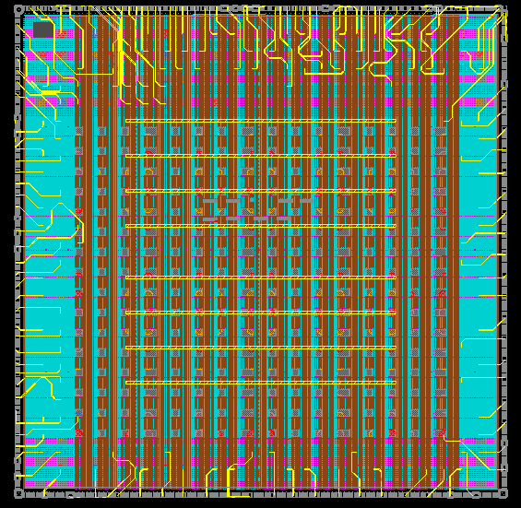
Our Design Philosophy
Practice what we preach
Use agile practices in the design of our tools and hardware
Continuous integration
Rapid design cycles
Plan multiple tapeouts / year
Eat our own dogfood
Use our tools to create our prototypes
Use our prototypes to create new systems
Run a focused project
Already have taped out our first test chip

Slide 33
Video Analysis
Cloud-scale video data mining
Image processing and DNN inference on millions of hours of video
Offline training on video collections
Real-time video stream (& multi-stream) processing
Computational photography, autonomous vehicles, VR
Low latency, ultra-low power deployments
Always on sensing/wakeboarding, sense/process/display

Slide 34
Halide Compiler Work
Auto-schedulers
Both for Halide and for Halide like IR (joint work with Google)
Generating hardware from Halide
Jing’s work for line buffered pipelines
Xuan’s work for dense linear algebra (xNN)
Steven’s system glue to connect them to user applications
Extending the framework to more dynamic applications

Slide 35
AHA toolchain
Image processing DSLs: e.g., Halide, DNN IRs
Dataflow / Tensor
autoscheduler
Magma/Chisel
Gensis2
Verilog
Halide backend
CoreIR (LLVM for HW)
SMT
Checking
Fast simulation
SMT-based verification / PNR
Optimization/Analysis Passes
Technology/Mapping Passes
Host code
FPGA
Stanford CGRA
(with accelerators)
ASIC

Slide 36
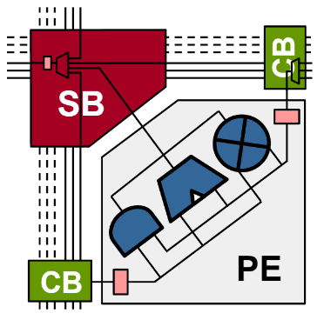
CGRA

Slide 37
The Journey is Just Beginning
Thanks for helping with this project
It is so nice to be excited about VLSI design again

